Slide 1
Movies/TV
Maa ka Aashirwaad

Slide 2
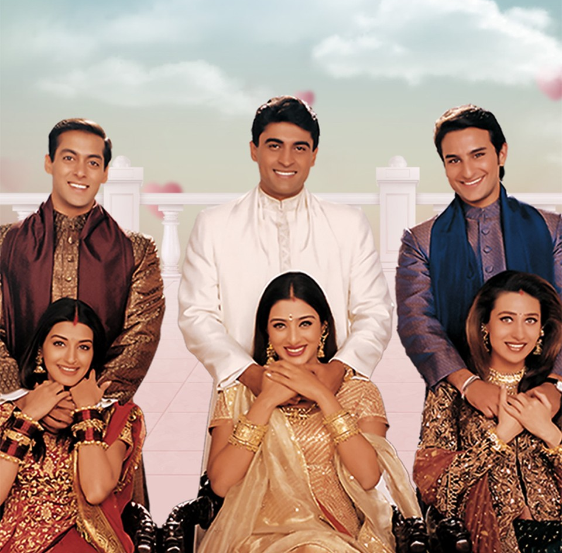
Guess the Movie

Slide 3
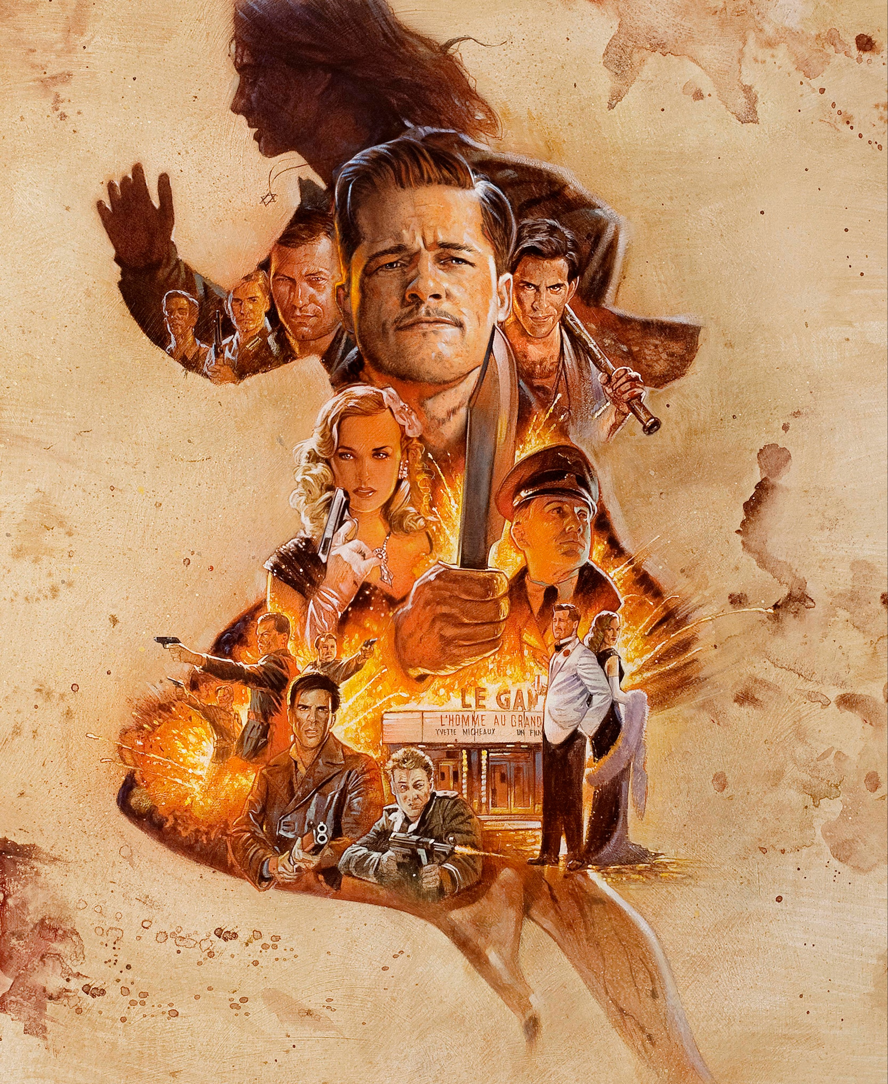
Guess the Movie

Slide 4
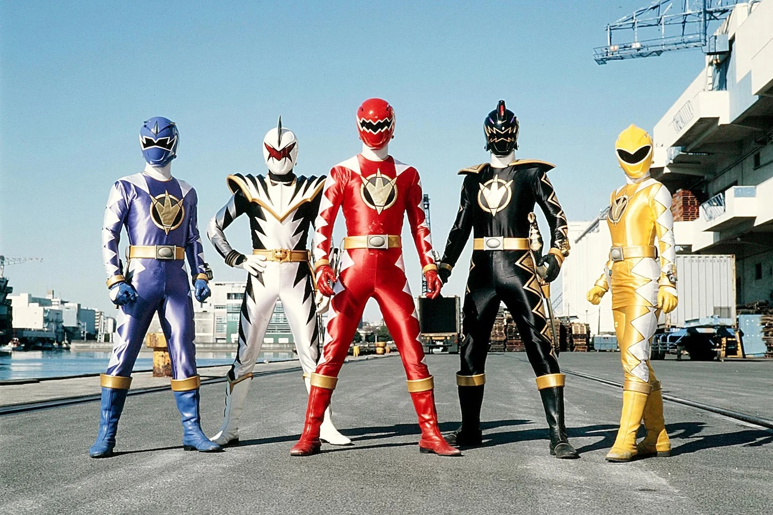
Guess the TV Show

Slide 5
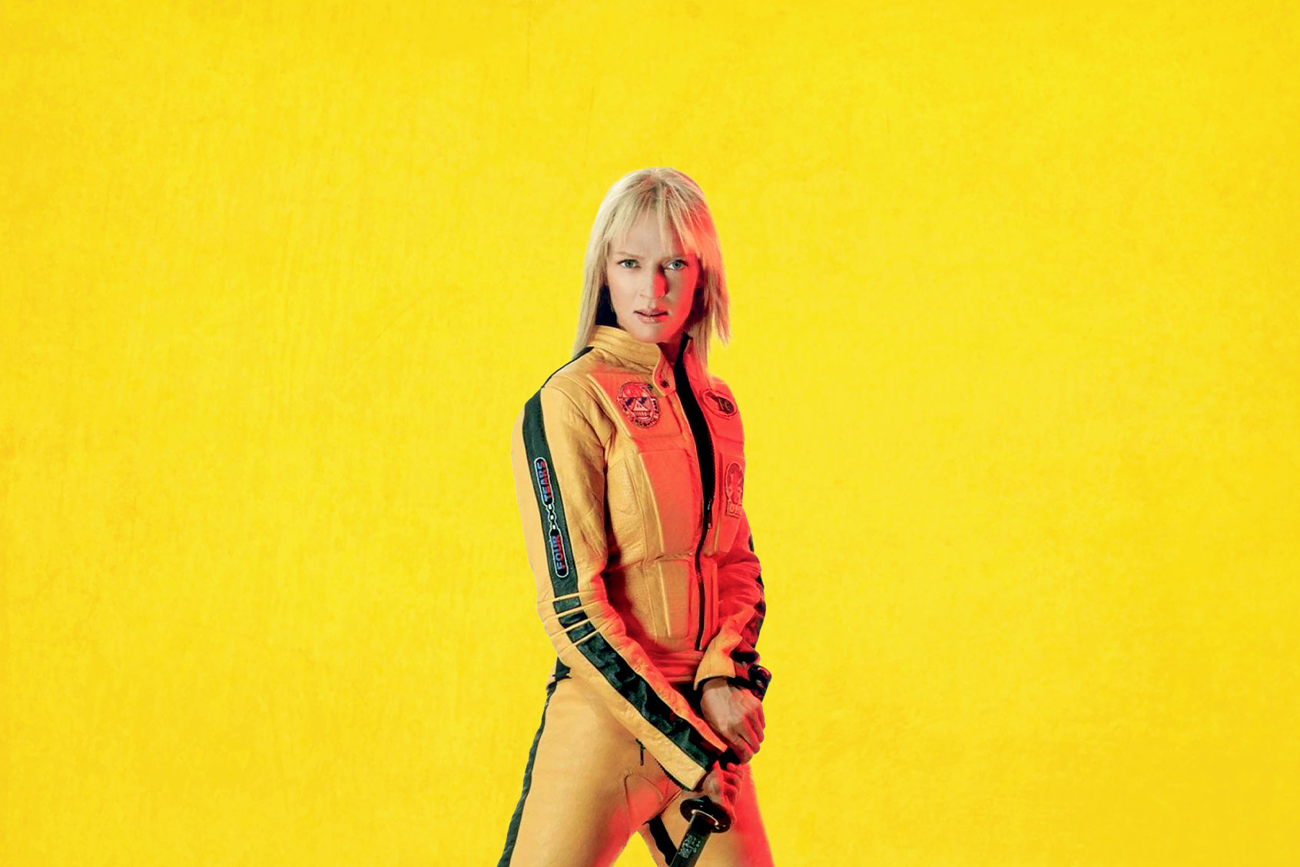
Guess the Movie

Slide 6
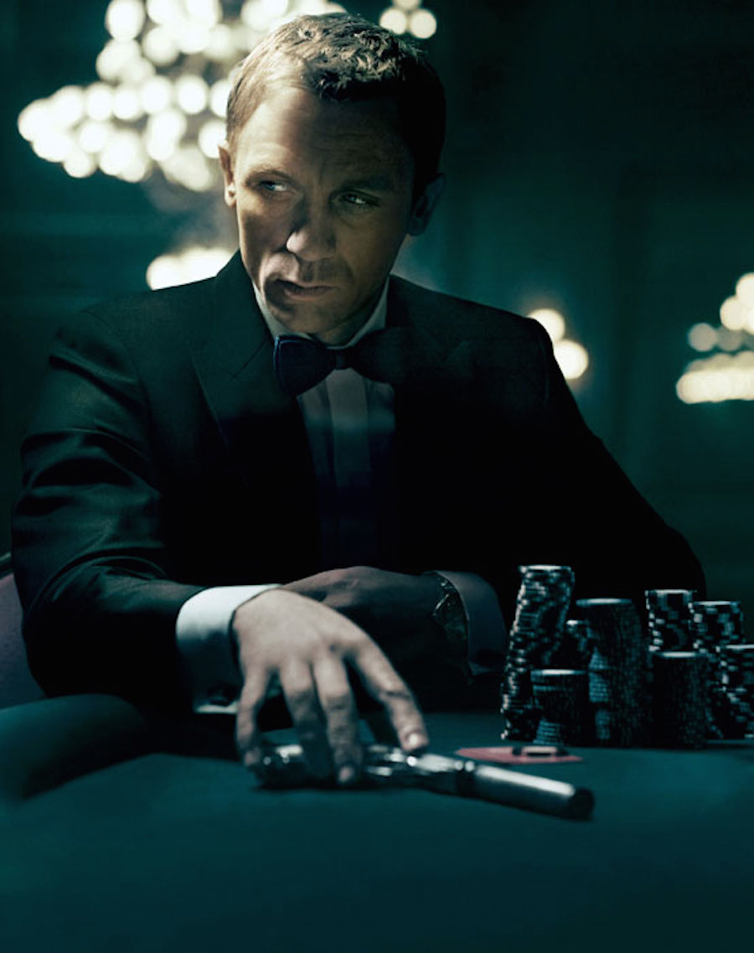
Guess the Movie

Slide 7

Guess the Movie

Slide 8
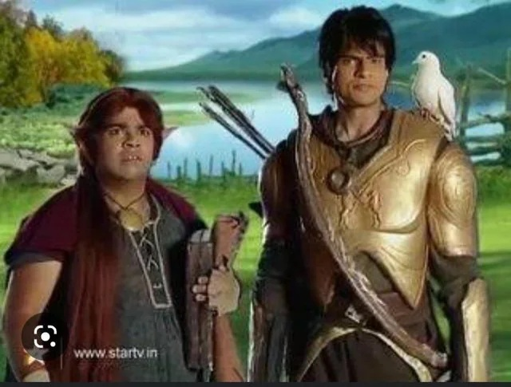
Guess the TV Show

Slide 9

Guess the Movie

Slide 10
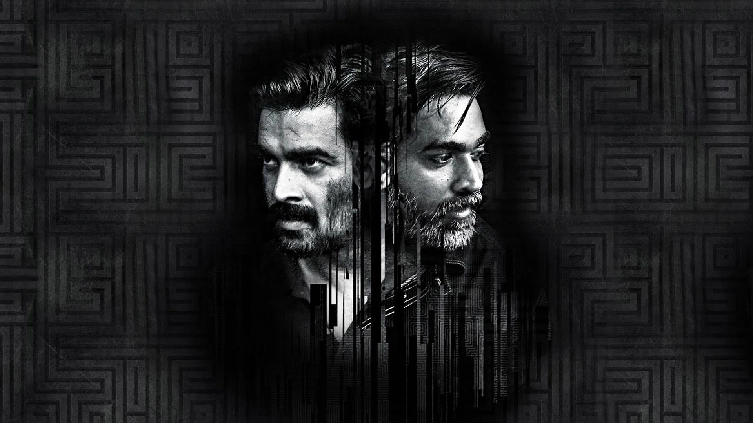
Guess the Movie

Slide 11

Guess the TV Show

Slide 12
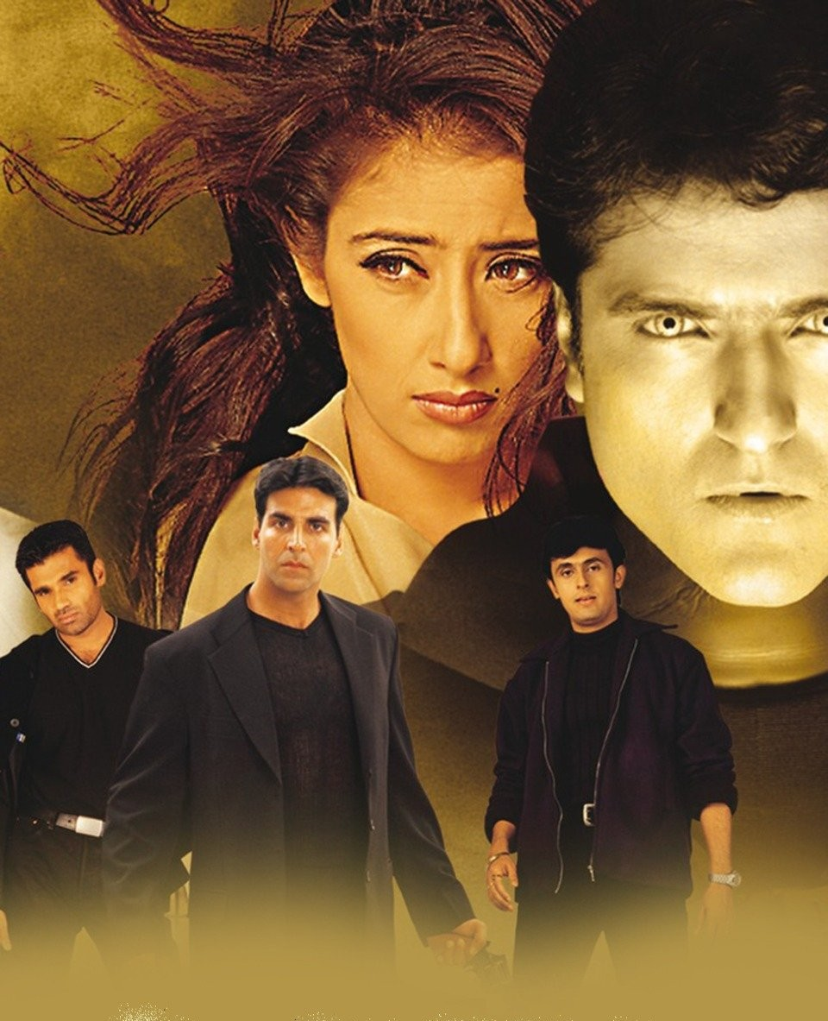
Guess the Movie

Slide 13
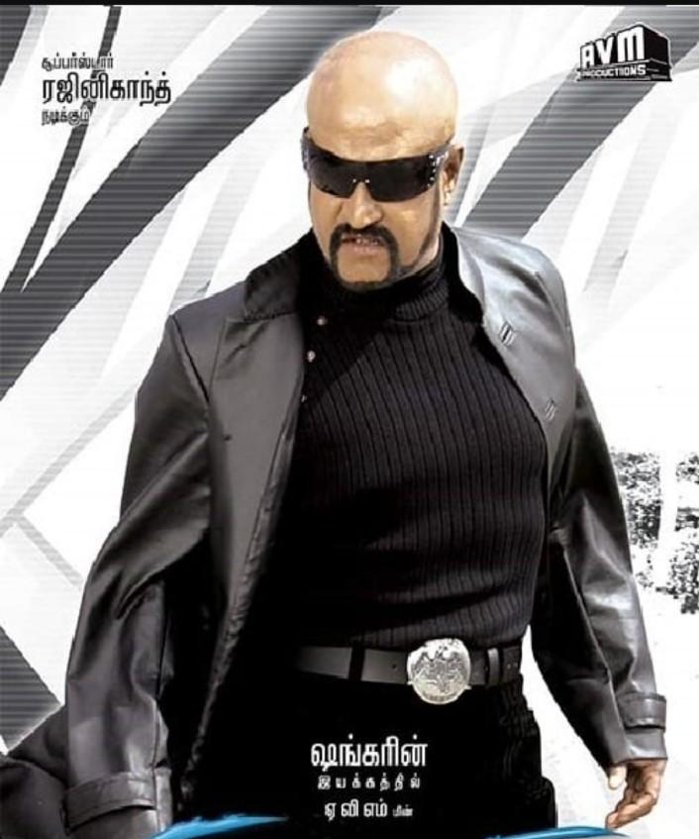
Guess the Movie

Slide 14
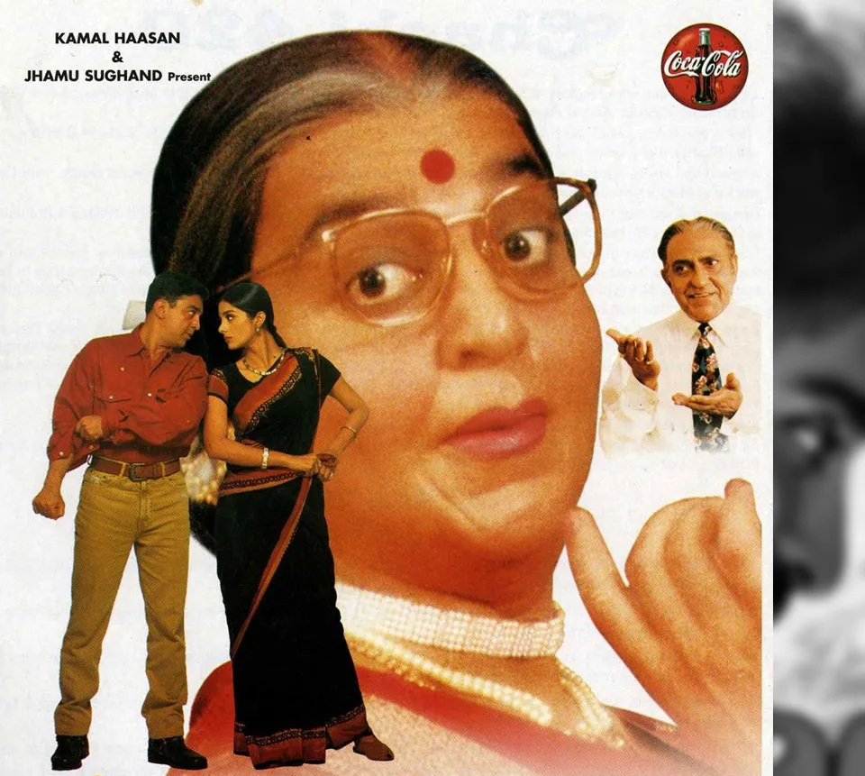
Guess the Movie

Slide 15
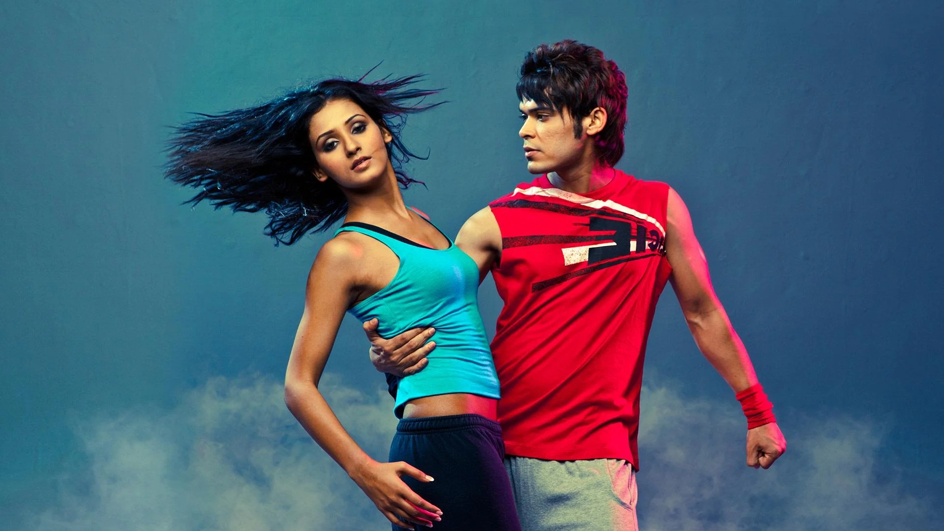
Guess the TV Show

Slide 16
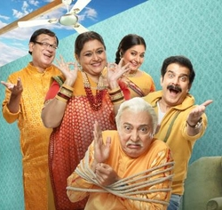
Guess the TV Show

